Slide 1

Advanced Software Development
Flight-Gear Simulator Controller
Final Project
Course number: #600098 Lecturer: Dr. Eliahu Khalastchi Developers: Gal Jacobson & Roey Miller
Notes:
Gal - HELLO every one, we are gal jacobson and roey miller, second year computer science student at the college of management academic studies.
We are going to present our Final project in Honolulu software development course.
Roey - This project is implements java programming with emphasis on design patterns and programming principles such as SOLID and GRASP.
In this project, we built a desktop application using Java, to control the flight-gear simulator

Slide 2
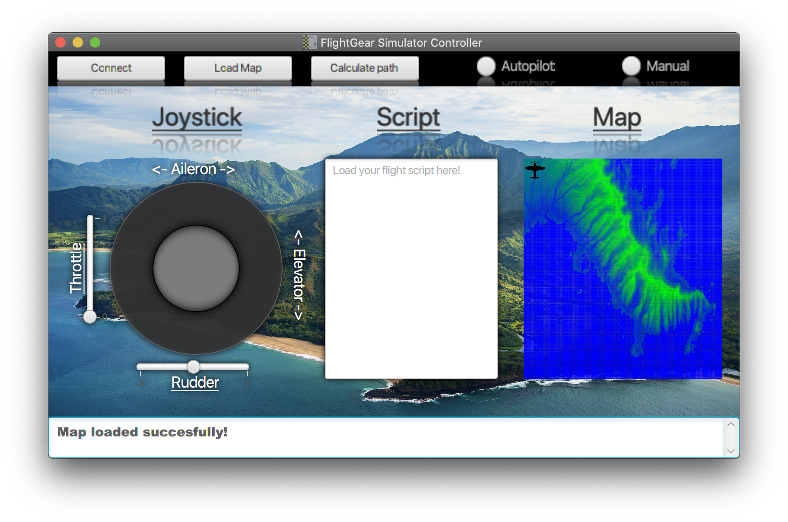
Project Milestones
1
General server side’s architecture design
Using GRASP and SOLID principles
2
Simple server solver
using smart cache-manager and file streaming
3
Implementation of BFS and A-Star algorithms
in the solver server
4
Script interpreter
using lexical analysis and syntax analysis
5
Designing and building a GUI Controller
using JavaFX
The Project App
Notes:
Gal - 1-2
Roey 3-5
The combination of all the milestones create our project app

Slide 3
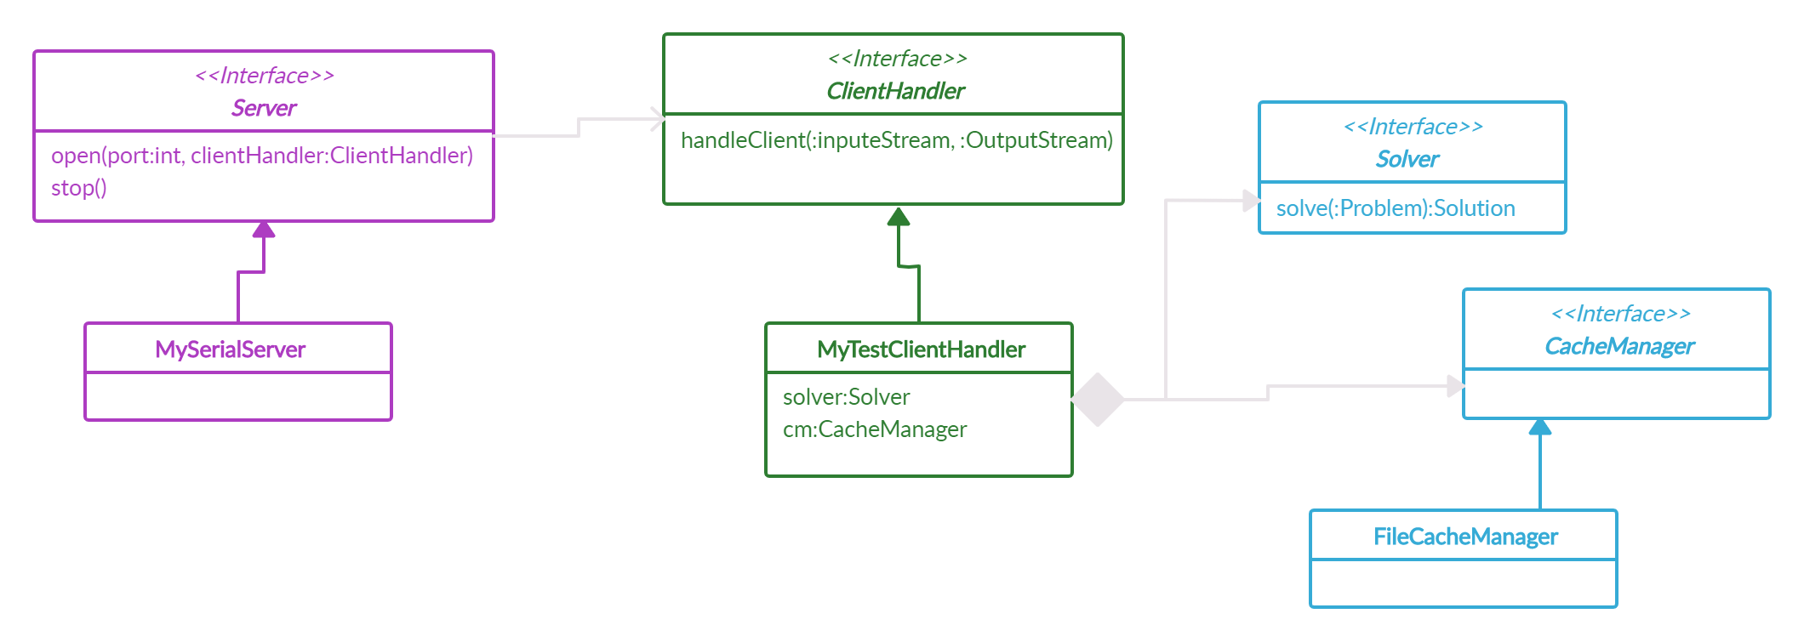
Server Side
Client-Server Architecture
Notes:
Roey - the server side is implemented a generic solver server which using a smart cash manager the saves solution and pull them by demeaned , by that we maintain the SOLID and GRASP principles.

Slide 4
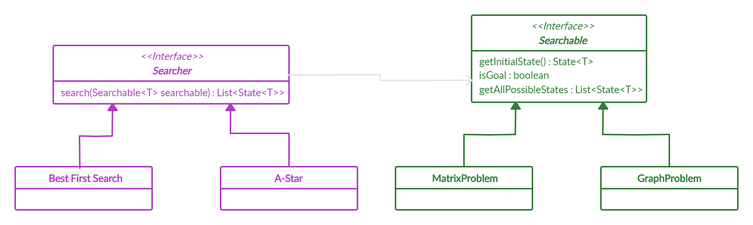
Server Side
The Problem Solver
Notes:
Roey - The problem solver
here we are using the bridge design pattern in our project.
we created separation between the problem and the algorithms to solve them. In our case giving a matrix problem can be solve by a star or bfs algorithms that find the chipset path to our destination

Slide 5
Script Reader
Script
Lexer
Parser
Simulator
Custom Language
Lexical Analyzer
Functional Analyzer
Send to Simulator
Notes:
Gal - The script reader
the script reader work in the following way;
The Program load the script
The laxer analyse the lexical part of it
The parser analyse the functional part of it which return costumes commands to the simulator
And the last part is to send the command to the simulator using the script file that had made.

Slide 6

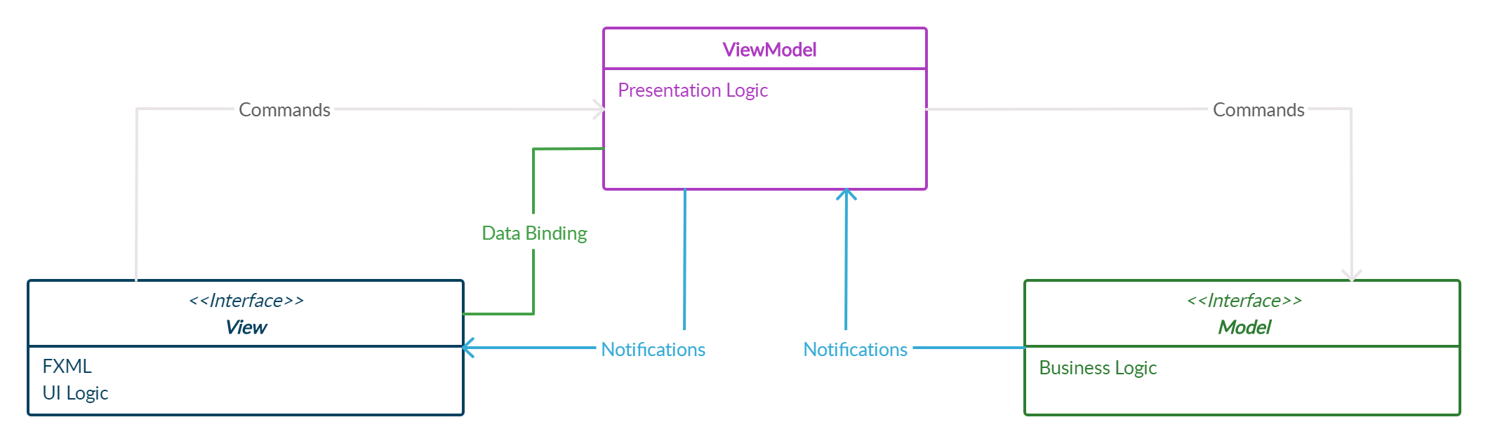
JavaFX GUI
MVVM Architecture
View
Graphical user interface (GUI)
Controllers and the ViewModel
ViewModel
Connecting the view(GUI) to the Model(Logic Side)
Hold conmon Objects
Model
The Business Logic Side
The Functions
Notes:
Roey - JavaFX GUI
now we will talk about the javafx graphical user interface, in this project we’ve implement the mvvm architecture - MODEL , VIEW AND VIEW MODEL.
The view side is represent the gui and holds in itself the view model and controllers , and using data-binding with view-model.
The model is responsible on the Business logic part and the functions.
The view-model is responsible to connect the view side and the model side and holds in itself the common objects

Slide 7
Joystick data binding
JoystickController
Aileron.Bind(VM.Aileron)
Elevator.Bind(VM.Elevetor)
Throttle.Bind(VM.Throttle)
Rudder.Bind(VM.Rudder)
ViewModel
setThrottle()
setRudder()
setJoystick()
SimulatorModel
SendToSimulator()
Notes:
Gal - Joystick Controller
this is an example off how the data binding between the view and the view-model works
The joystick object - throttle, rudder, aileron and elevator are binned to the same object that stored in the view model,
When a change is accord, it send the changes to the view-model which send it to the model who return the new values and they will update in the view side by using the observer and observable interfaces.

Slide 8

The Team
Gal Jacobson
Roey Miller
B.Sc. Compute Science Student 2ND year
B.Sc. Compute Science Student 2ND year
Gal Jacobson
Roey Miller
Jacobsongal@gmail.com
roeymillerp401@gmail.com
JacobsonGal
RoeyMiller
Notes:
Roey - this is our git repository that we used to manage this project
Gal - we hope you had a great experience with us .
We are gal Jacobson and rosy miller and we will glad to connect you in LinkedIn and GitHub
Roey - Thank you for watching !

